Slide 1




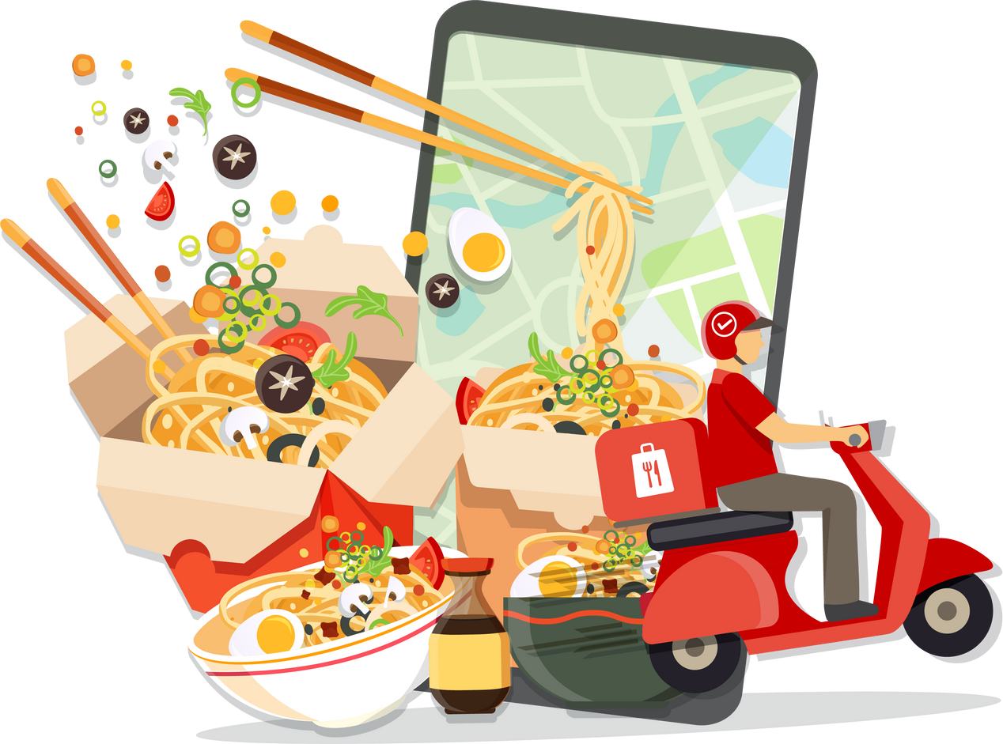
Zomato Analytics
Project
Presented by- Group- 6
Anand, Firdos, Manisha, Rashmi, Ratnam, Roshan, Tanvi

Slide 2

Introduction to Project
Objective: Analyze Zomato data for insights on customer preferences, growth, and trends Tools: Excel (cleaning), SQL (queries), Power BI (dashboards), Tableau (storytelling)
Focus Areas: Ratings, cuisines, price ranges, delivery adoption, geography
Goal: Improve customer satisfaction s identify market potential

Slide 3

Objectives of the Project
Project Objective:
The main objectives of this analysis are:
To study restaurant growth over time and across geographies.
To analyze customer ratings and satisfaction levels.
To evaluate cuisine performance and preferences.
To understand cost patterns and delivery adoption trends.

Slide 4


Tools Used
Excel
Initial data exploration, missing values handling, pivot analysis, charts.
Tableau
Interactive dashboard with filters, parameters, and actions.
SQL
Querying large dataset, joins, group by (restaurants by year, cuisines, countries)
Power BI
Slicer-enabled Interactive dashboard with KPIs, bar charts, DAX measures

Slide 5





Data Overview
Dataset:
Total Restaurants: 9,551
Total Cuisines: 250 Total Votes: 1.5M+ Countries Covered: 15
Cities Covered: 141
Data period: 2010 – 2018

Slide 6

Process
Excel:
Data cleaning, basic pivot tables, initial trend checks.
SQL:
Queries applied to extract insights
Focus areas: cuisines, countries, yearly growth trends
Power BI:
Built dashboards to visualize key metrics Added interactivity for deeper exploration.
Tableau:
Created visually appealing dashboards Designed for storytelling with:
Filters, KPI cards

Slide 7
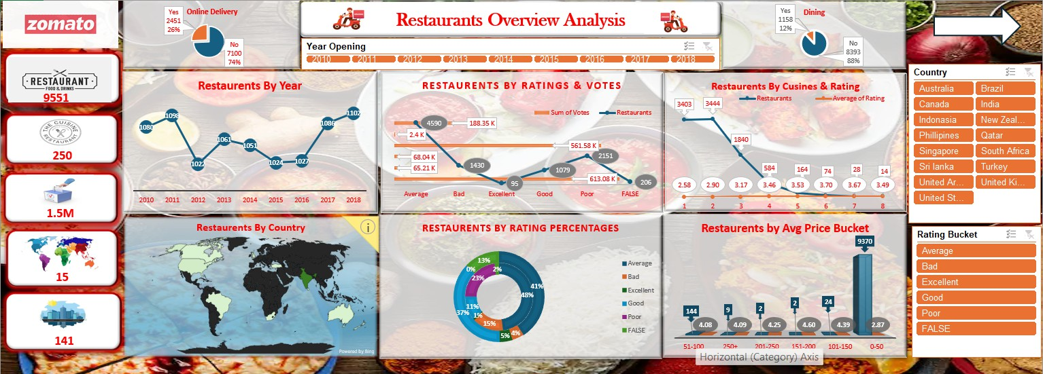
Excel Dashboard

Slide 8
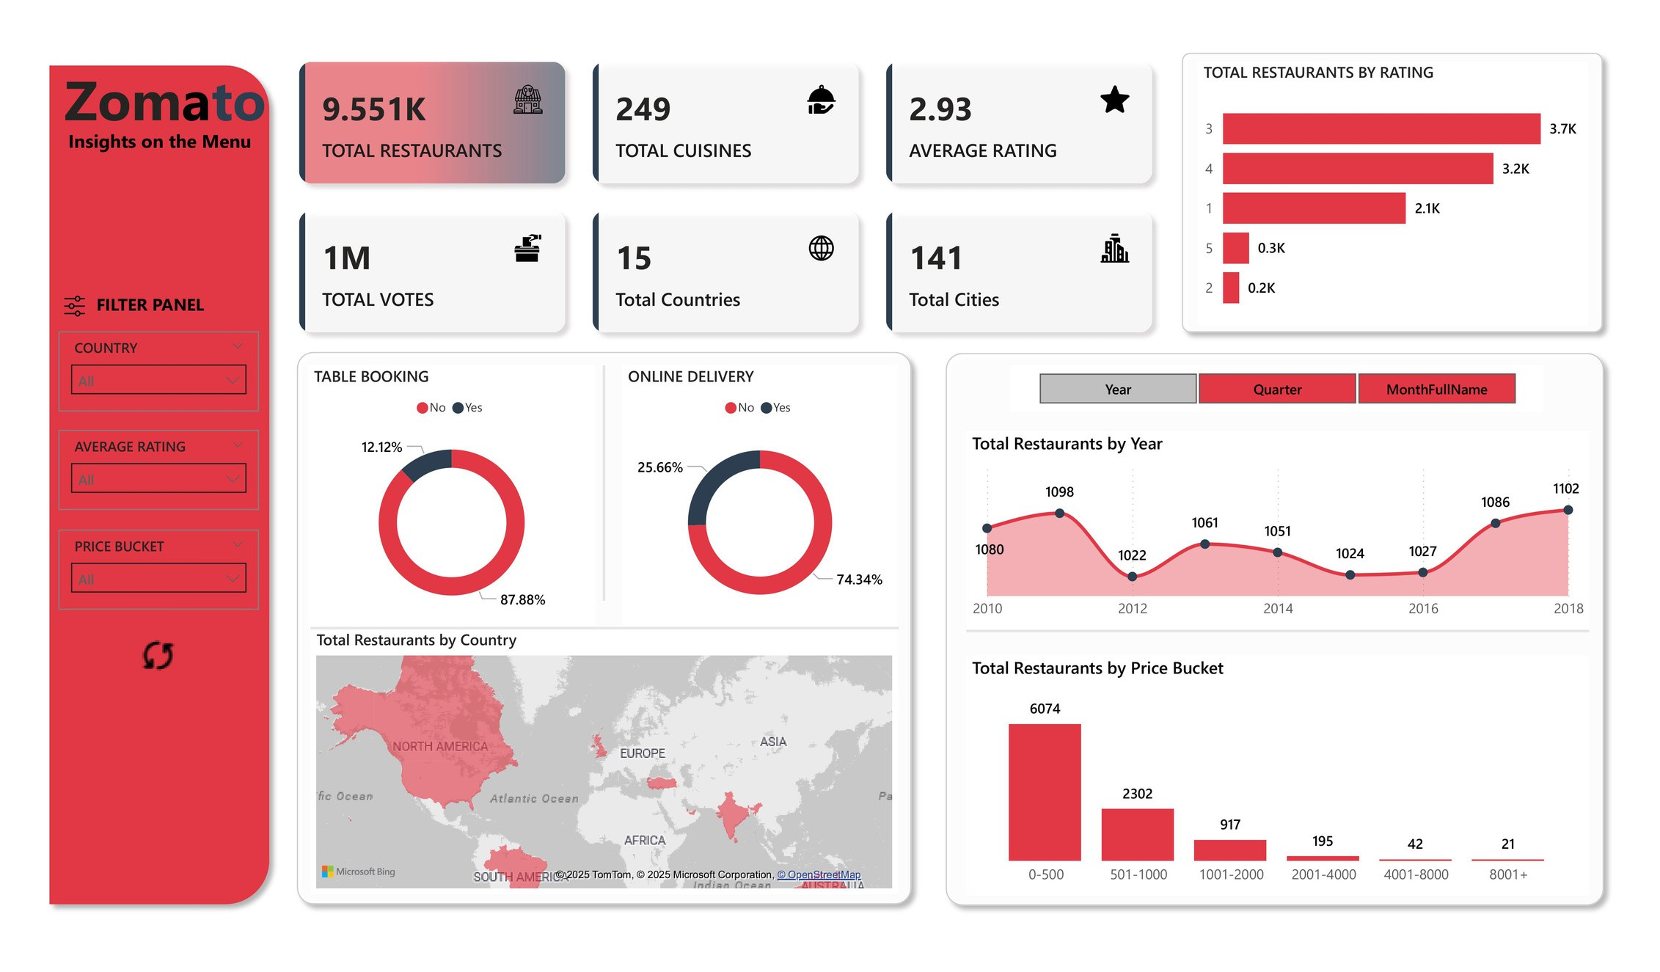
Power BI Dashboard

Slide 9
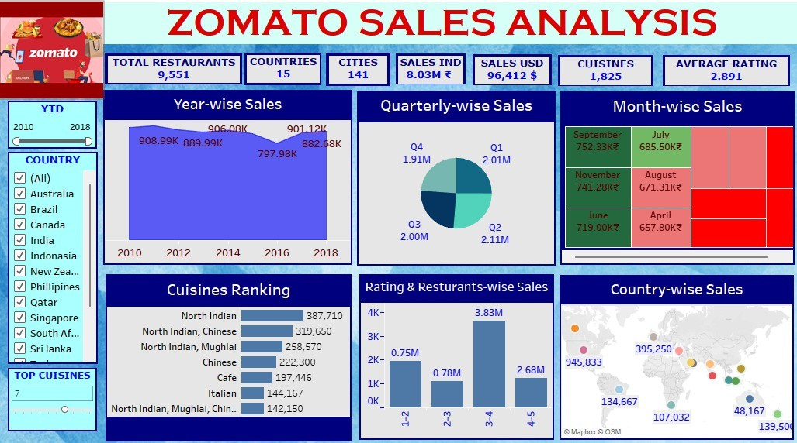
Tableau Dashboard

Slide 10

Challenges s Learnings
Challenges:
Loading and managing large datasets Handling missing/inconsistent data Ensuring accuracy in SQL queries
Designing dashboards that are both interactive and easy to interpret
Learnings:
Importance of combining tools: Excel → Data cleaning
SQL → Querying
Power BI → Dashboarding Tableau → Storytelling
Realized the critical role of visualization in simplifying complex insights

Slide 11

Recommendations s Insights
Restaurants should:
Maintain affordability without compromising quality
Expand multi-cuisine offerings to attract diverse customers
Work on reducing delivery time to improve customer experience
Zomato should:
Optimize search filters
Enhance recommendation engines Provide personalized experiences to users

Slide 12

Key Insights s Findings
Ratings Gap: Majority restaurants rated average/poor, few achieve 4+
Cuisines: North Indian s Chinese dominate sales; niche cuisines score better ratings
Geography: India (esp. New Delhi) leads by huge margin in restaurants s sales
Cost: Avg. spend ≈ $10 (~₹600–₹700); low–mid range dominates, luxury under-represented
Trends: Sales peaked in 2011 s 2018, Q2 strongest quarter, Sept highest month
Delivery: Only ~25% adoption, strong growth potential ahead

Slide 13
Conclusion
The analysis shows growth in numbers but not in quality
By focusing on customer preferences, Zomato can:
Strengthen market position Enhance customer loyalty Improve satisfaction levels overall

Slide 14



Thank you very much!

